Slide 1

Evaluating housing trends for home buyers in king county
Michael Flores
Flatiron School

Slide 2

Introduction
Going through the process of buying a house requires proper diligence.
You want to make sure you can balance a house’s features and affordability.
Evaluating previous housing sale data allows you to determine how to pick the best house!

Slide 3
Assumptions
We will be looking at houses sold in King County from
2014 – 2015
Our analysis consisted of only houses that meet necessary code requirements
Historical trends reflect the housing market at the time

Slide 4
Questions Answered
How have housing sizes changed and how does it affect its selling price?
How much does a house’s yard space affect its price?
How have a home’s bedroom/bathroom ratio changed over the years?

Slide 5
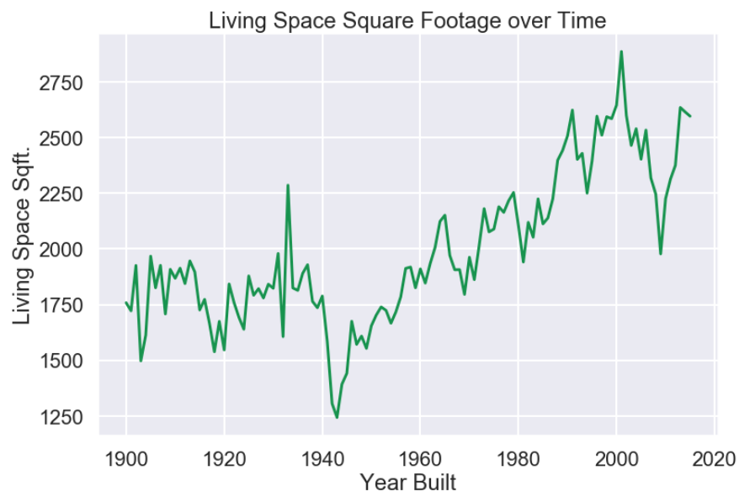
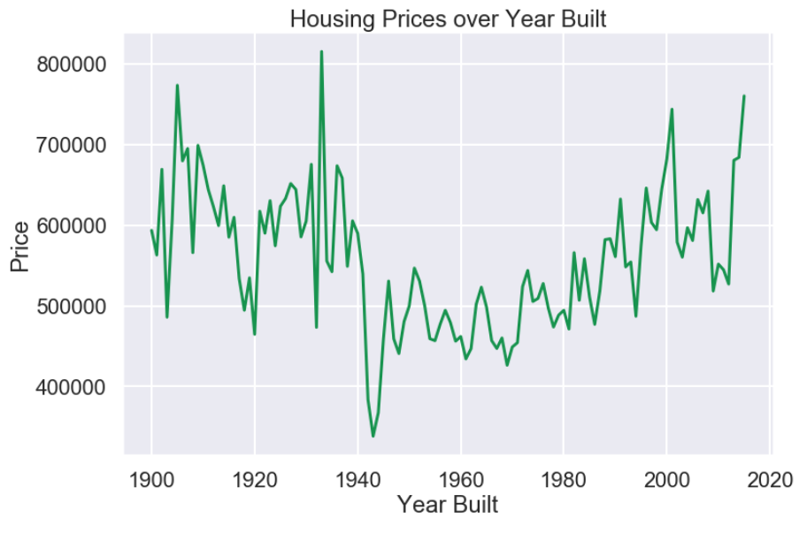
Housing AGE/size trends and price
I looked at the average living square footage and prices based on the year a home was built.
Housing prices greatly fluctuate but living spaces have gotten larger over recent years.
Pre-war houses retain their value despite smaller home sizes.

Slide 6
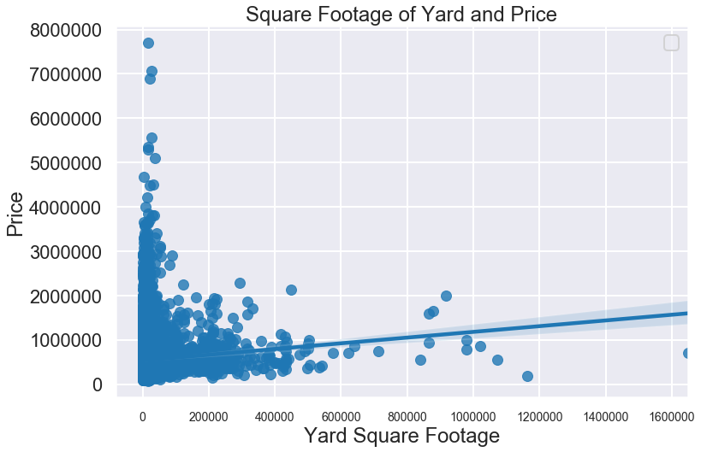
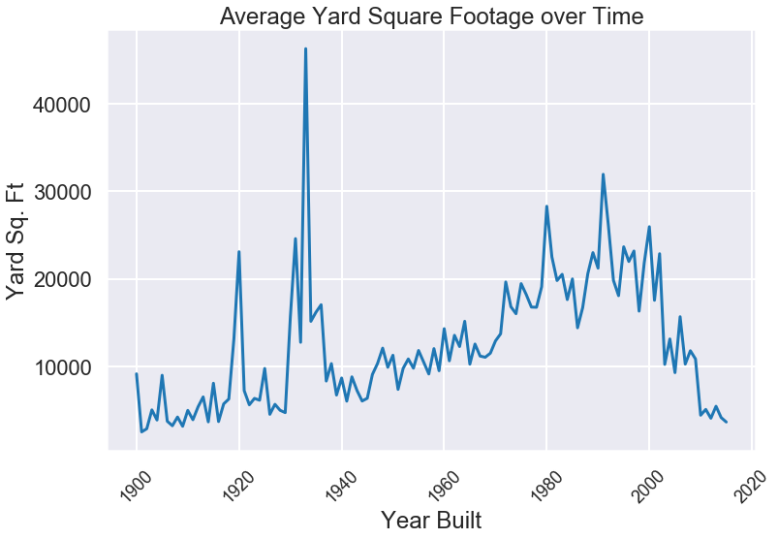
Yard Area and price
I analyzed the square footage of all home yards for price and historical trends.
Positive correlation between the amount of square footage and overall price.
Modern homes generally have less yard space available.

Slide 7
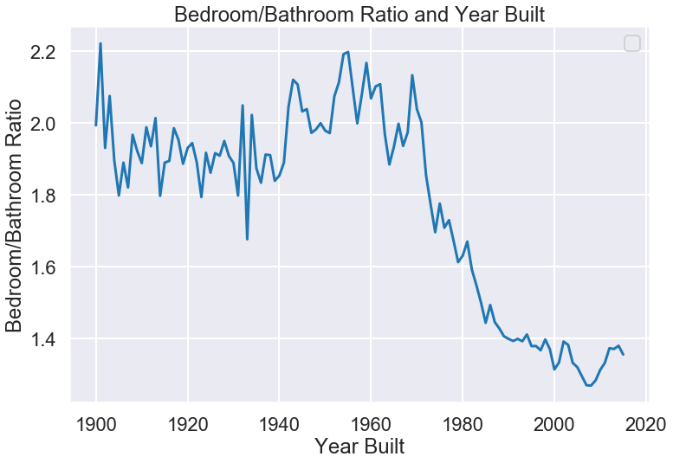
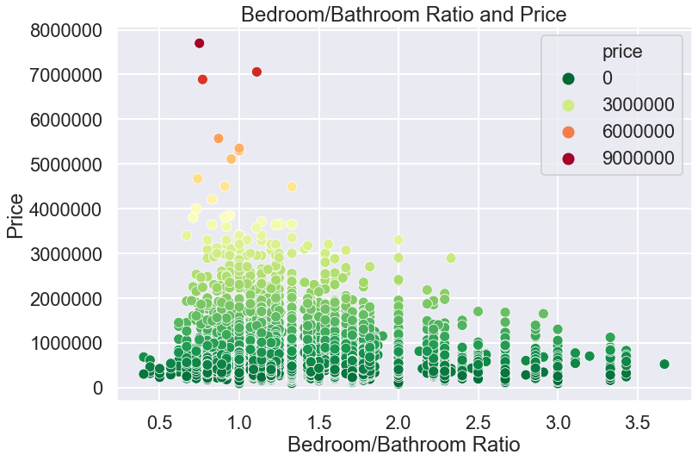
Bedroom/bathroom Ratio
I looked at how the number of bedrooms and bathrooms changed over time.
Modern homes have lower, more desirable ratios.
Higher priced homes generally have lower ratios.

Slide 8
Findings and Recommendations
Modern homes are generally more desirable in terms of space and features
Older homes retain their value despite certain drawbacks in their design
Look at houses built after the 1980s and before 2000s for right balance

Slide 9

Future studies
What effect does crime and safety in a neighborhood have on a home’s price?
What other home features and designs have an impact on a house’s price?
How does proximity to public amenities affect a home’s price?

Slide 10
Thank you!
Michael Flores

